Slide 1

Vidyavardhini’s College of Engineering & Technology
K.T. Marg, Vartak College Campus, Vasai Rd, Vasai-Virar, Maharashtra 401202
Disease Prediction System using Supervised Learning
Group Members:
1. Dhanashree Raut
2. Amruta Poojary
3. Ayush Bujare
4. Divyen Gharat
Date : 16-10-2023

Slide 2
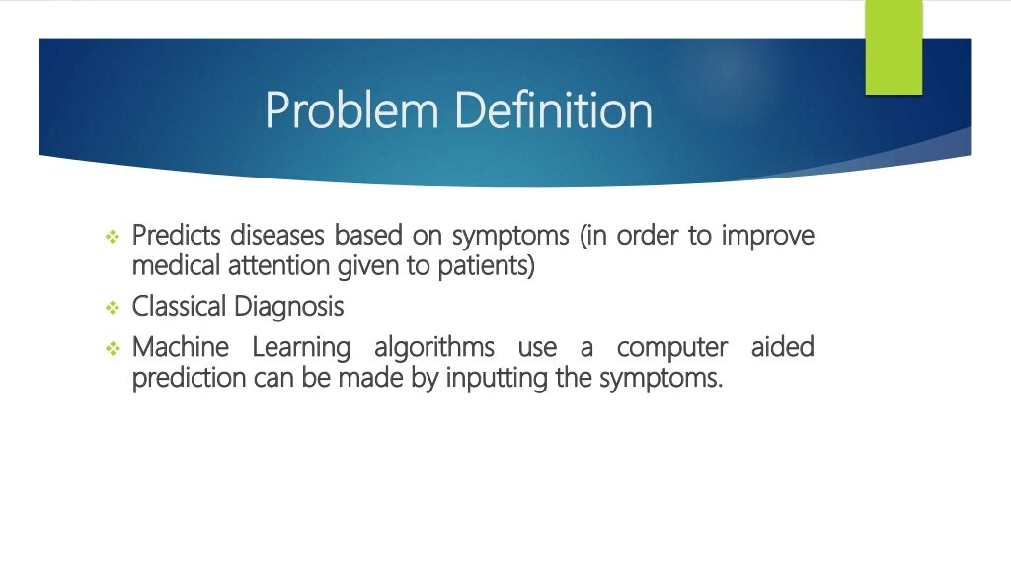

Introduction
Disease Prediction System, powered by Naive Bayes, ensures accurate and efficient identification of diseases based on symptoms, improving the diagnostic precision.
By assisting healthcare professionals, our system contributes to enhanced patient outcomes and more effective healthcare delivery.

Slide 3
The problem: Accurate disease prediction is vital in healthcare, yet it's challenging due to factors like human error and complex diseases.
Misdiagnoses can harm patients, and timely prediction is crucial for quality care.
Our solution: A Disease Prediction System using Naive Bayes for precise, efficient symptom-based disease identification, aiding healthcare professionals for better patient outcomes.

Slide 4
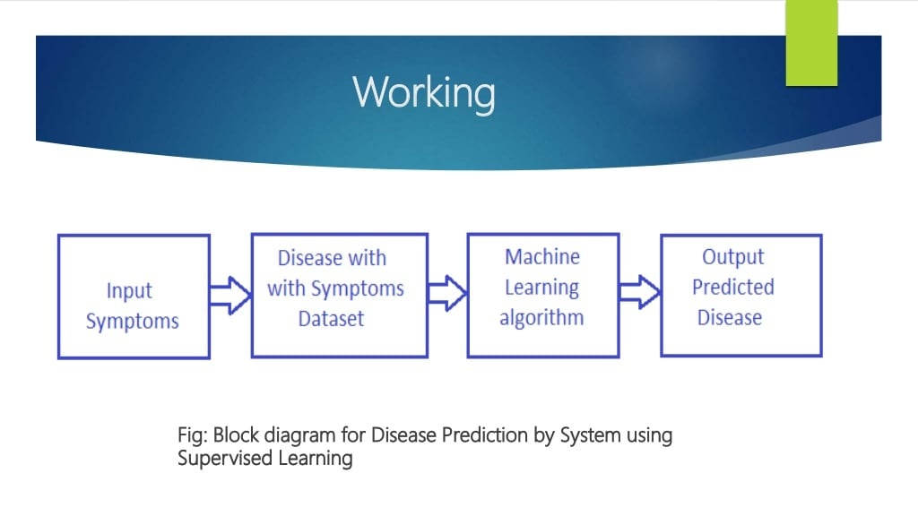

Slide 5
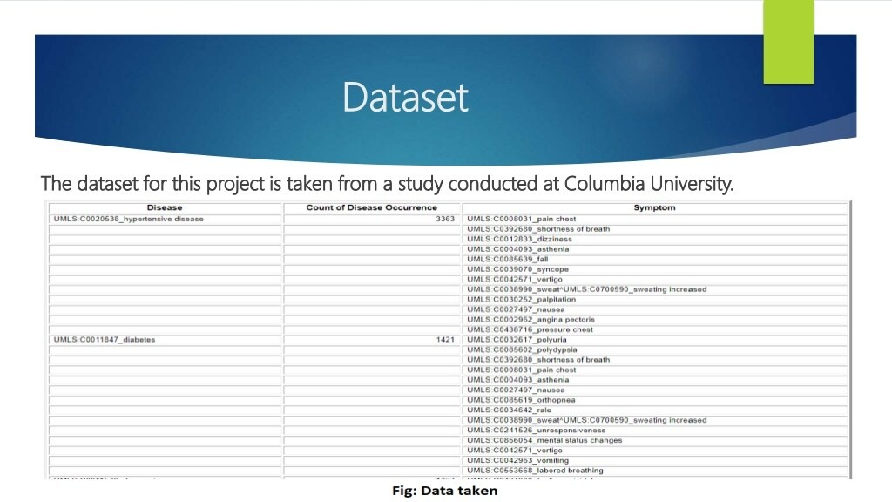

Slide 6
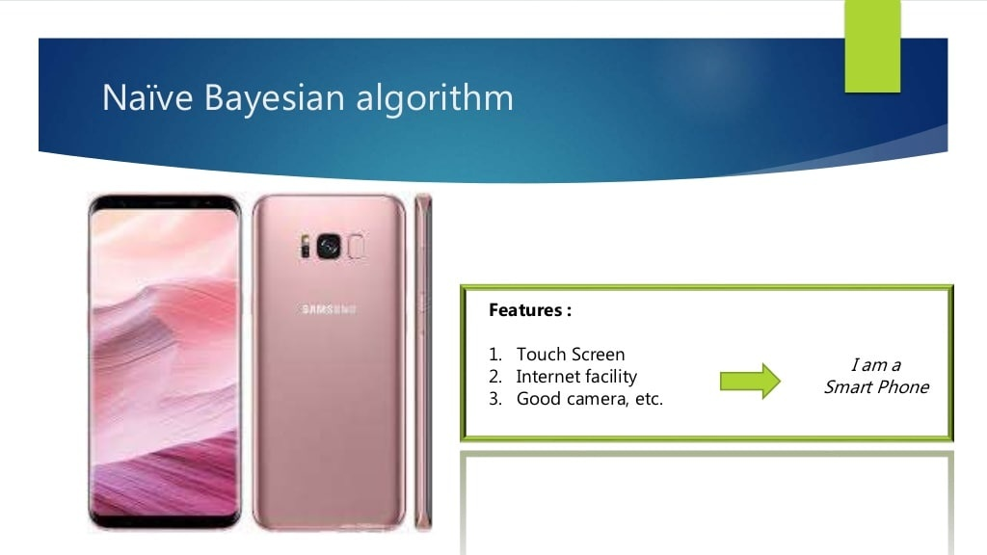

Slide 7
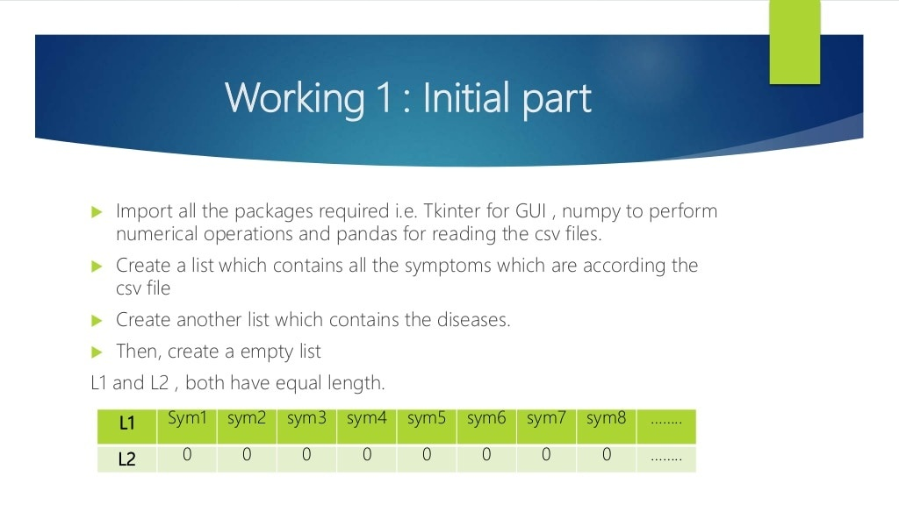

Slide 8
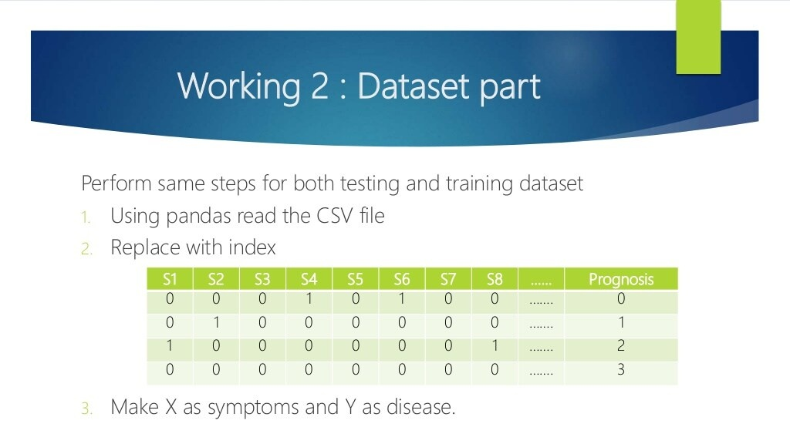

Slide 9
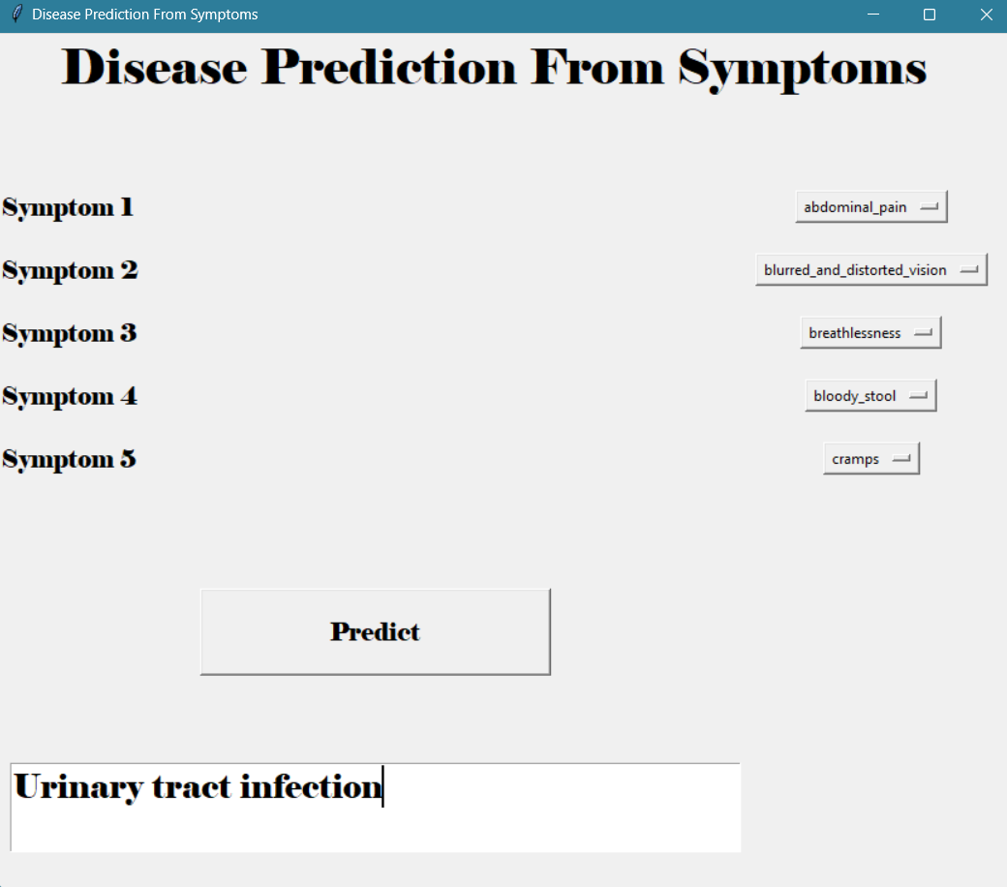
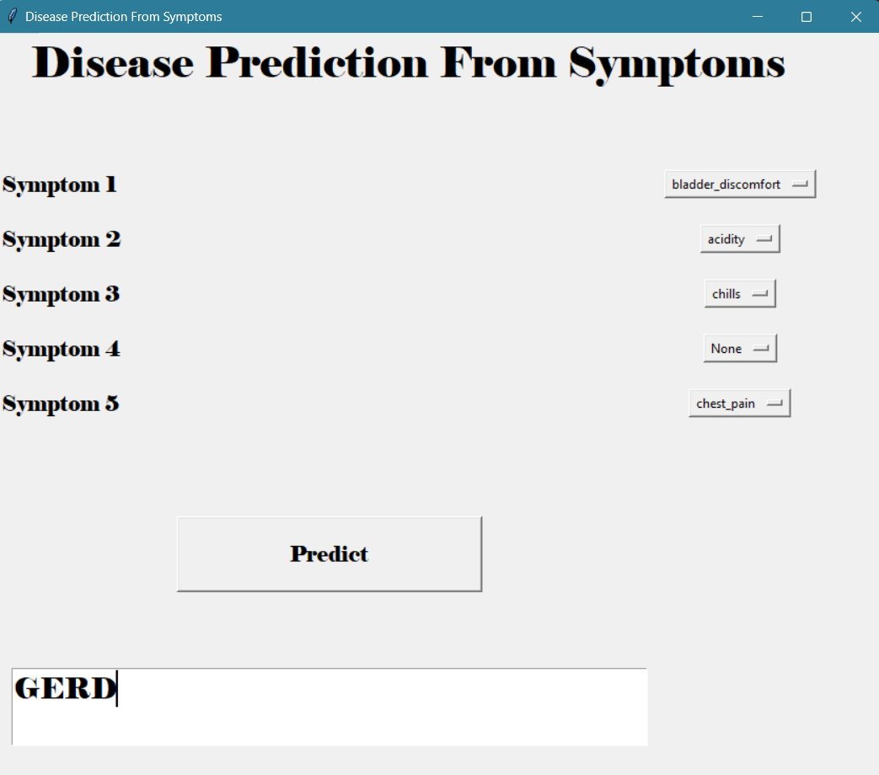
Output

Slide 10
Conclusion
Disease Prediction System represents a significant step towards accurate and timely disease identification. The utilization of Naive Bayes and symptom-based analysis offers a promising path for healthcare professionals, ensuring more precise diagnostics and ultimately improving patient care.

Slide 11


